Slide 1

We will start shortly. In the meantime...
Gather what you need to be comfortable and join our Pre-Session Chatter!
Experience with online classes
Previous college courses
Current or prior employment
_______________________________________________________________
As part of this session, you may need to know how to:
Activate and deactivate voice and video
Send chats and join breakout sessions
Notes:
Yumiko

Slide 2

Reminder: Session will be Recorded
Notes:
Yumiko

Slide 4
MBA Degree-seeking Learner
Webinar

Slide 5

Webinar Overview
Introductions
Coursera Program Overviews
Degree Student Resources
Question and Answer (Q&A’s)

Slide 6
Introductions

Slide 7
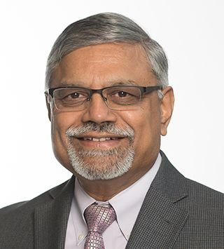

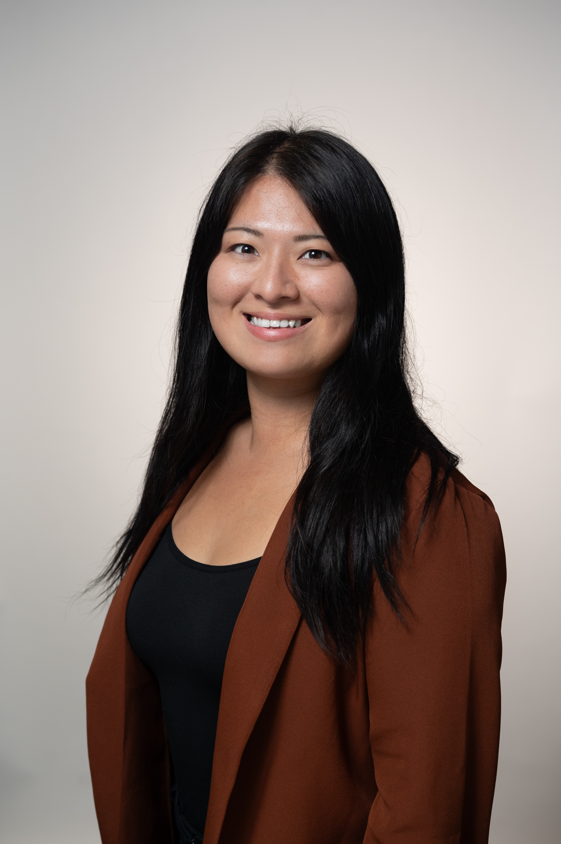
Dr. Krishna Erramilli
Associate Dean, Program Director, MBA Coursera, Professor of Strategy
Dr. Curt Allee
Assistant Dean Academic Enrichment, Career Management, & Student Engagement
Yumiko Saito
MBA Academic Advisor

Slide 8
MBA Program Overview
Notes:
Krishna

Slide 9

Master of Business Administration (MBA): Overview
"WE ARE A TECH MBA"
Mission: We train management professionals that excel in forward-looking, tech-focused organizations.
Typical Duration: 15 to 24 months
Total Credits = 36
  Required Courses = 24 credits
  Specialization Courses = 12 credits
Specializations
  Business & Technology
  Business Analytics
Notes:
Krishna
Specializations:
Core MBA curriculum plus the three specialization courses shown for each.
MBA (Business and Technology)
This M.B.A. degree gives you the tools and expertise to leverage technology in today’s rapidly-changing business environment and to succeed in all kinds of management positions and leadership roles, especially in organizations and industries where technology plays a critical role.
MBA (Business Analytics)
Learn high-level management skills and how to leverage insights from data analytics and predictive modeling to optimize operational efficiency, develop and grow new products and markets, increase profits, and create new business opportunities in competitive global markets. Careers include management positions at all levels related to organizational and operational efficiency, market research, supply chain and logistics, and business analytics.
MBA (Quantitative Finance)
Receive training in management and finance that distinctively prepares you for managerial and consulting careers in a broad range of companies and public sector/governmental organizations where an understanding of finance, financial instruments, and financial markets is an asset.

Slide 10
Step 1: Conditional Admission (3 PBA Credits)
Performance-Based Admission PBA Courses (3 Credits)
MBA 701 Competitive Strategy (1 credit) – Krishna Erramilli
MBA 702 Managerial Economics (1 credit) – Priyanka Sharma
MBA 703 Mastering Excel Essentials (1 credit) – Liz Durango-Cohen
Passing means earning a minimum of B Grade in all of the assessments in these courses
Notes:
Krishna

Slide 11
Step 2: Full Admission (6 Post-PBA Credits)
Post PBA Courses (6 Credits)
MBA 706 Innovation & International Strategy (2 credits) – Krishna Erramilli
MBA 707 Business Econ. & Game Theory (2 credits) – Priyanka Sharma
MBA 708 Comprehensive Excel Masterclass (2 credits) – Liz Durango-Cohen
Notes:
Krishna

Slide 12
After Full Admission
(27 Credits = 15 Core + 12 Specialization)
Core Courses (15 Credits)
MBA 501 Financial Statement Applications (3 credits) – Mike Rybak
MBA 506 Leadership and Org. Design (3 credits) – Smriti Anand
MBA 511 Marketing Strategy (3 credits) – Rob Nelson
MBA 513 Operations and Process Management (3 credits) – Jeffrey Berk
MBA 590 Digital Transformation (3 credits) – Marian Cook
Business & Technology Specialization (12 Credits)
MBA 532 Artificial Intelligence (3 credits) – Siva Balasubramanian
MBA 572 New Technology Ventures (3 credits) – Nik Rokop
MBA 522 Transformational Leadership (3 credits) – John Walden
MAX 501 Digital Marketing (3 credits) – Katan Patel
Business Analytics Specialization (12 Credits)
BUS 550 Business Statistics (3 credits) – Ghazale Haddadian
MAX 522 Predictive Analytics (3 credits)- Dinakar Jayarajan
MAX 507 Visual Analytics (3 credits) – Elizabeth Durango-Cohen
MAX 523 Social Media Marketing Analytics (3 credits) – Ketan Patel
Notes:
Krishna

Slide 13
Credit for Prior Learning (Industry Certificates)
ELIGIBLE CERTIFICATES
MBA students can substitute one of the specialization courses with CPL (see list of eligible certificates).
Apply via this link Credit for Prior Learning Certificate Submission (Post-PBA)
Submit certificate after passing PBA courses and before graduation.
Application will be reviewed, and decision will be communicated to you as to whether it is approved and which MBA course can be replaced with the certificate.
Google Project Management Professional Certificate
Google Data Analytics Professional Certificate
Google Advanced Data Analytics
Google Business Intelligence
Google Digital Marketing & E-Commerce
IBM Data Analyst
IBM Data Science
Microsoft Power BI Analyst
AWS Cloud Technology Consultant
AWS Solutions Architect Advanced Certificate
Notes:
Krishna

Slide 14
MBA Yearly Schedule
 | Fall A | Fall B | Spring A | Spring B | Summer
PBA | MBA 701 | MBA 701 | MBA 701 | MBA 701 | MBA 701
PBA | MBA 702 | MBA 702 | MBA 702 | MBA 702 | MBA 702
PBA | MBA 703 | MBA 703 | MBA 703 | MBA 703 | MBA 703
Post PBA |  | MBA 706 | MBA 706 | MBA 706 | MBA 706
Post PBA | MBA 707 | MBA 707 |  | MBA 707 | MBA 707
Post PBA | MBA 708 | MBA 708 |  | MBA 708 | MBA 708
Core |  | MBA 501 |  | MBA 501
Core | MBA 506 |  | MBA 506
Core |  | MBA 511 |  | MBA 511
Core | MBA 513 |  | MBA 513
Core |  | MBA 590 |  |  | MBA 590
Bus Tech | MBA 532
Bus Tech |  |  |  | MBA 522
Bus Tech |  |  | MAX 501
Bus Tech |  | MBA 572
Bus Analytics |  |  | BUS 550
Bus Analytics |  | MAX 523
Bus Analytics |  |  |  | MAX 507
Bus Analytics | MAX 522
Disclaimer: Coursera course schedules are subject to change due to instructor availability and other unforeseen circumstances.

Slide 15
Degree Student Resources

Slide 16
Illinois Tech Coursera Website
https://www.iit.edu/coursera

Slide 17


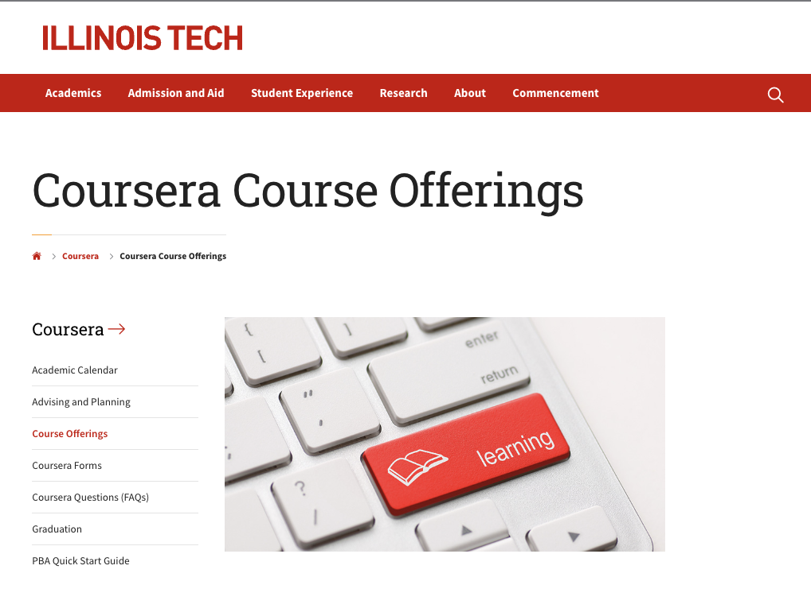
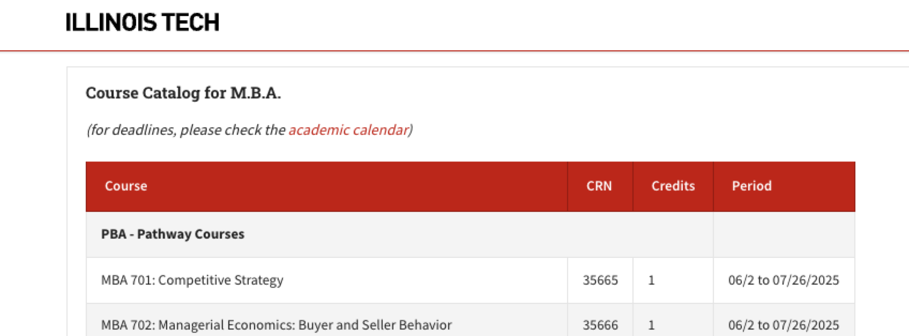

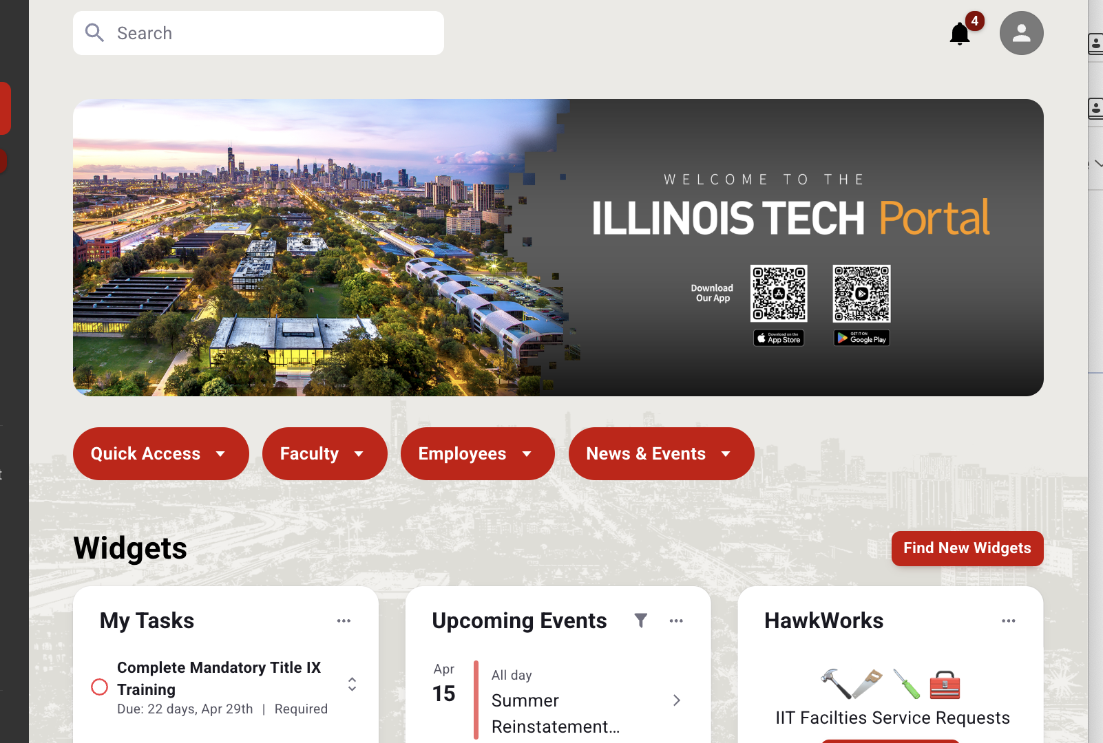

Core Degree Course Registration
Identify course(s)
Refer to the corresponding CRN number found on the Coursera Course Offerings landing page is the only way to confirm you are in the correct course.
CRN
If you are having issues with registration,
please submit a ticket to mba-support@illinoistech.edu
Log into the Illinois Tech Portal page. and select REGISTER AND PAY to get your Pin

Slide 18
Degree Works
What is DegreeWorks
DegreeWorks is a planning tool on Illinois Tech Portal to help students and advisors monitor student's progress toward degree completion. DegreeWorks provides a more accessible, convenient, and organized way for students to know where they are academically and how they can plan the rest of their college careers.
DegreeWorks is not a substitution for consultation with an academic advisor. Please always check with your advisor or email mba-support@illinoistech.edu if you have any questions or concerns.

Slide 19
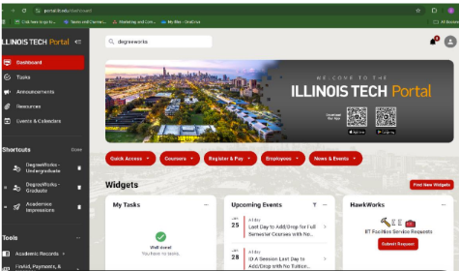
DegreeWorks Tutorial
Type "degreeworks" in the IIT Portal search bar and choose "Degree Works Graduate"

Slide 20
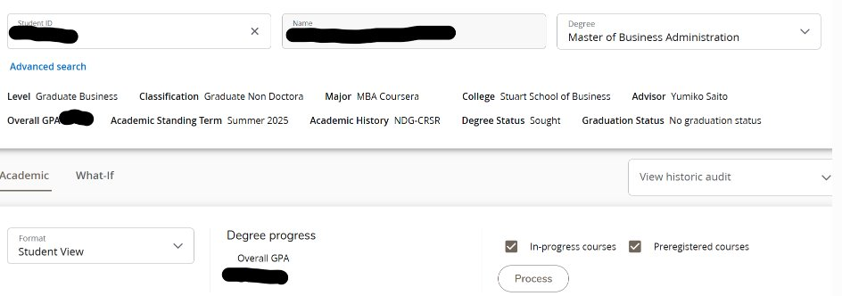
DegreeWorks Tutorial

Slide 21
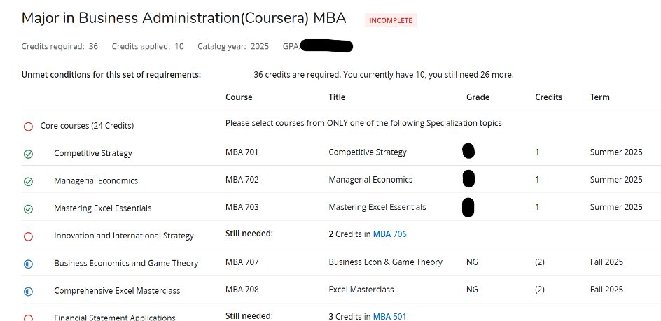
DegreeWorks Tutorial

Slide 22
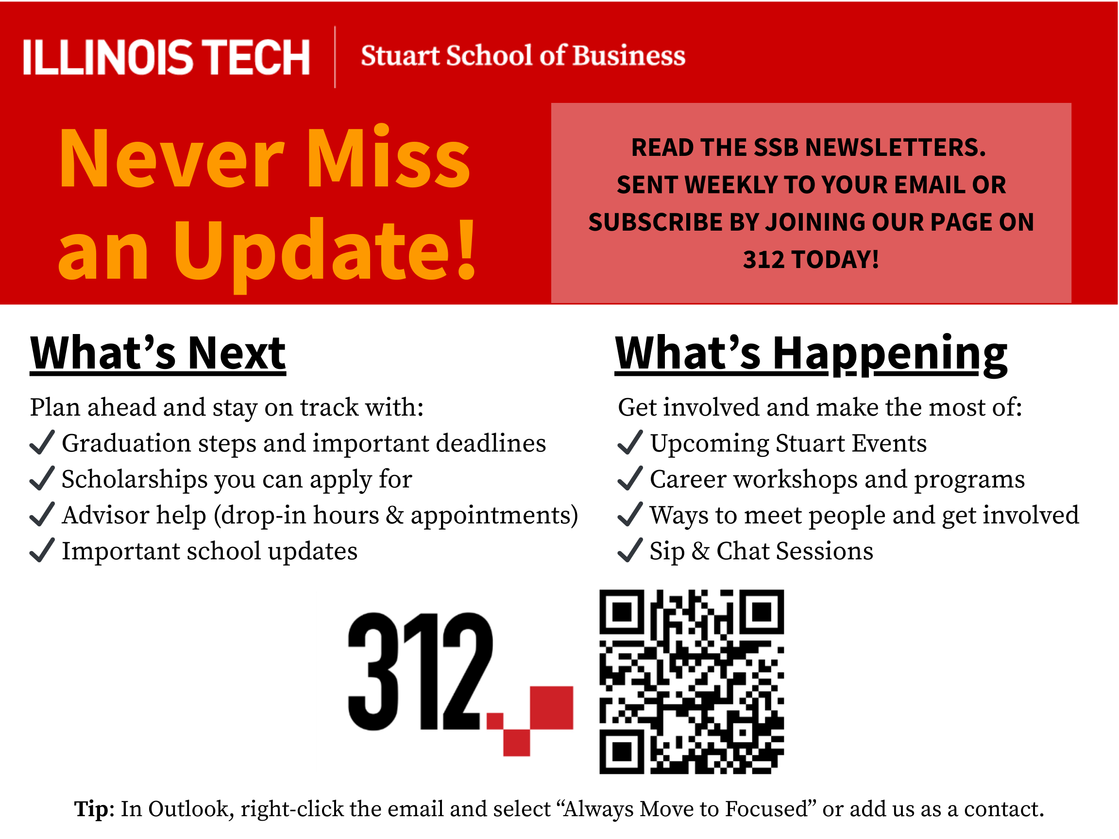
Additional Resource for Degree-seeking Students
Newsletters via 312
Advisor Help: See drop-in hours and appointments
Virtual Events: There are many online events tailored for Coursera students living in and outside of Chicago.
Chicago Connections: If you happen to be visiting the city or live in Chicago area, you can use it to find in-person events to join happening in Chicago.
It's a great way to stay connected to the broader campus community!
Graduation Guidance: Info sessions & key dates for your big day.

Slide 23
What can you do next?
Schedule time to chat!
You can find the link to book an appointment with your advisor on Illinois Tech Coursera Advising and Planning page
https://www.iit.edu/coursera/advising-and-planning
Email your questions!
If you have any questions or need any assistance, please send an email to mba-support@illinoistech.edu

Slide 24
Question and Answer (Q&A’s)

Slide 25
Thank you!
Feedback Survey

